Slide 1
Loading gauge enhancement studies
RAG - 27 May 2015

Slide 2
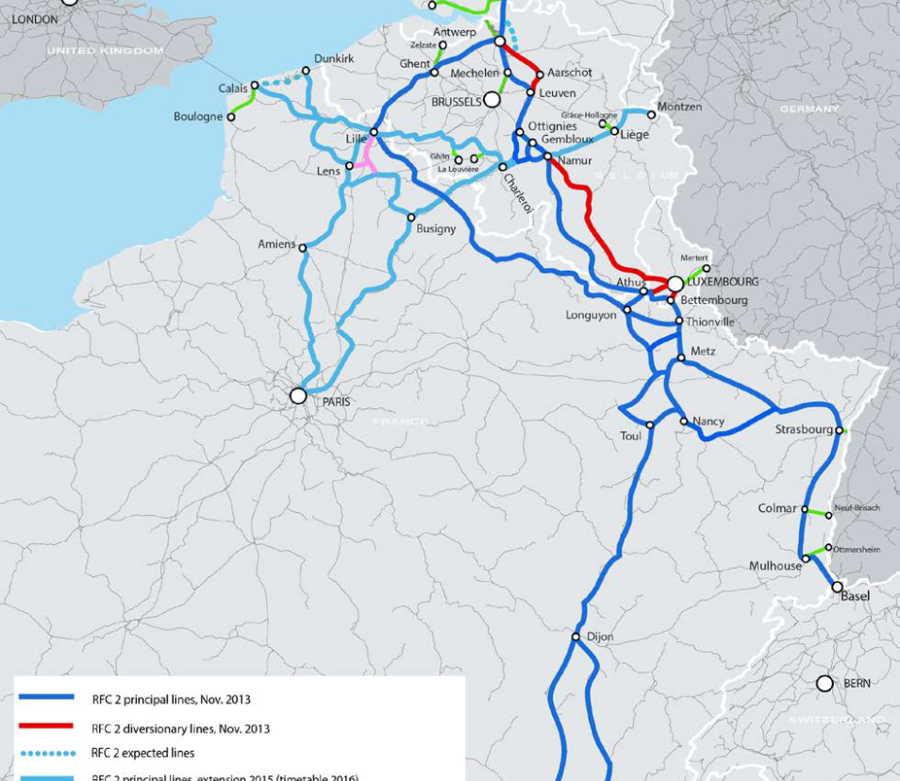
Geographical scope
This study focuses on the enhancement of loading gauge on the Calais – Longuyon – Luxembourg - Thionville – Metz – Strasbourg – Basel line
This line belongs to RFC North Sea – Med and is currently run by international trains
from Antwerp to Basel/Italy
from the UK to Basel/Italy
from Le Havre to Basel/Italy

Slide 3
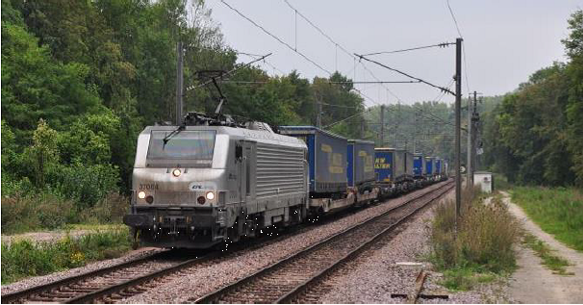
Customer needs
RFC North Sea – Med RAG members: allowing trains to carry 4m semi-trailers => traffic increase
Examples
Perpignan – Luxembourg
    4 returns a day by VIIA + Fret SNCF
Bettembourg – Lyon
    1 return a day by CFLMultimodal
Freiburg – Novara (RFC Rhine Alpine)
    11 returns a day by RAlpin
    Hupac, BLS, CFF Cargo and Trenitalia
    Bettembourg Trieste (through Germany)
Photo taken at the FR-LU border on 13/9/2014
(Bettembourg – Lyon service)

Slide 4

Agenda
Studies in France
Studies in Luxembourg
Studies in Switzerland
4/23

Slide 5
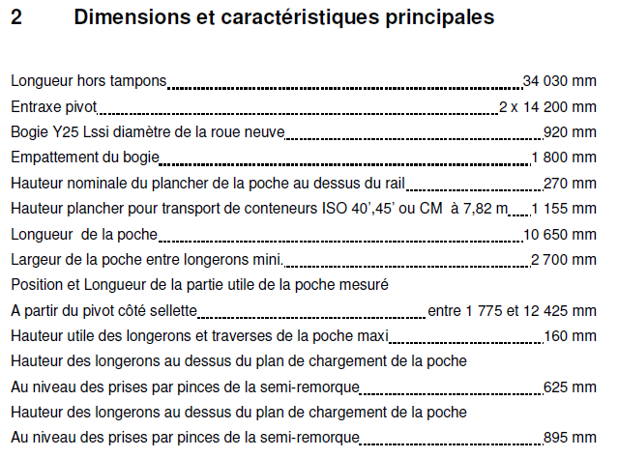
Customer needs
Wagons are usually owned by combined transport operators, not by the RUs. They all agree to request an infrastructure that allows the transport of 4m semi-trailers
The issue is: 4m above what ?
    SNCF Réseau launched a market study to know the opinions of RFC North Sea - Med clients
    SNCF Réseau interviewed 4 European combined transport operators interested by the transport of semi trailers on the corridor
    SNCF Réseau may interview another one or two
    Opinions diverge on this issue (total height of 425cm, 427 cm, 433 cm)
    427 cm is the highest existing standard that can be considered on conventional lines in France
Example: characteristics of a TWIN pocket wagon

Slide 6
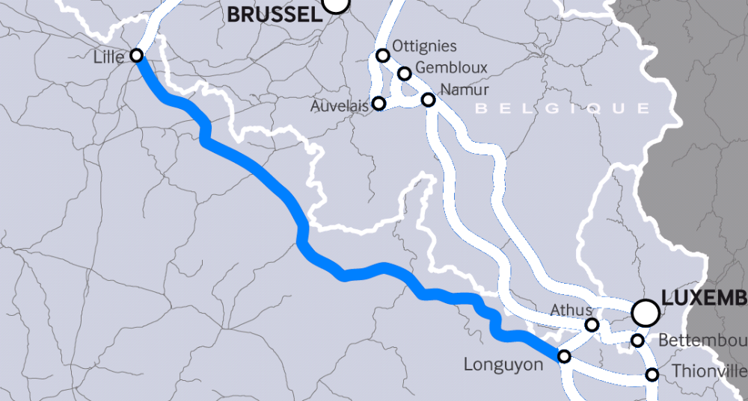
Calais – Longuyon: date of works
Tunnel de Montmédy
756m GB1
2016
Tunnel de Vachemont
344m GB1
2016
Tunnel de Liart
400m GB1
2015
Tunnel de Martinsart
165m GB1 2020

Slide 7
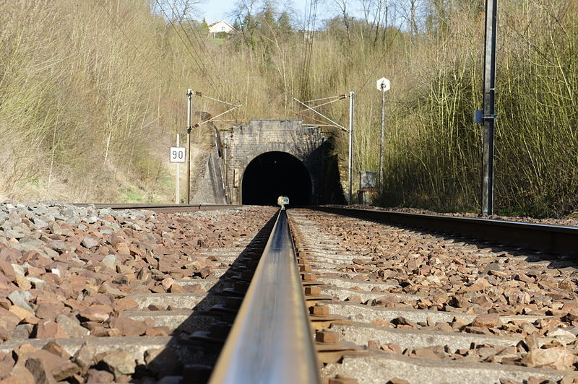
Vachemont (344m) + Montmédy (756m)
  Final studies were done between 2012 and 2014
  Works are planned from 04/2016 to 10/2016
  Total cost of the final studies ≈ 850k€₂₀₁₄
  Total cost of renewal + loading gauge enhancement ≈ 10M€₂₀₁₄
Photo : Montmédy tunnel

Slide 8
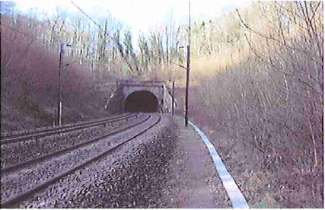
Martinsart (165m)
  Investigation studies started in 2014 and should be finished in 2015
  Works are planned in 2020 and should include a foundation raft
  Total cost of the final studies ≈ 850k€₂₀₁₄
  Total estimated cost of renewal + loading gauge enhancement : 4,2M€₂₀₁₀; this assumes a total closure of 8 weeks
Photo : Martinsart tunnel

Slide 9
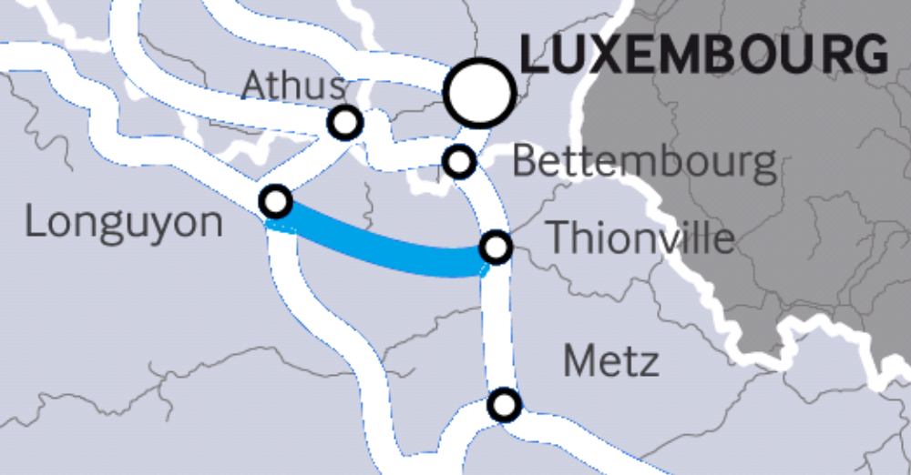
Longuyon-Thionville: date of works
Tunnel de Mercy
199m GB
Tunnel de Fontoy
325m GB
2024
Tunnel de la Platinerie
642m GB
2017

Slide 10
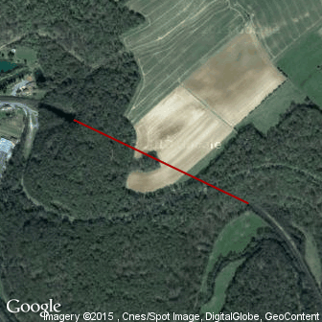
La platinerie (642m)
  Final studies started in 2014; it will be finished before 31/12/2015
  Renewal works planned in 2017 (4 months) with total line closure
  Estimated cost of the works (foundation raft + gauge enhancement): 13M€₂₀₁₃
  Estimated cost of the final studies 1,24M€ at current prices
Photo : La Platinerie tunnel

Slide 11
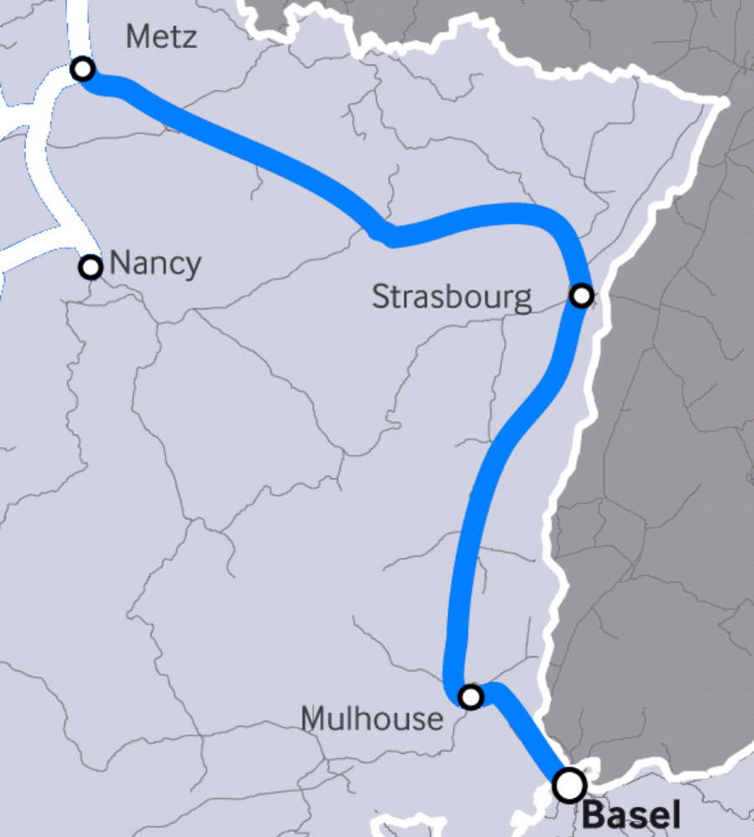
Metz-Basel
Tunnel de Niederrheinberg
Tunnel de Niederrheinthal
Tunnel du Haut Barr
Tunnel d’Arzviller
Tunnel de Hofmuhl
Tunnel de Lutzelbourg
Kannenfeld Tunnel
Schützenmatte Tunnel
11

Slide 12
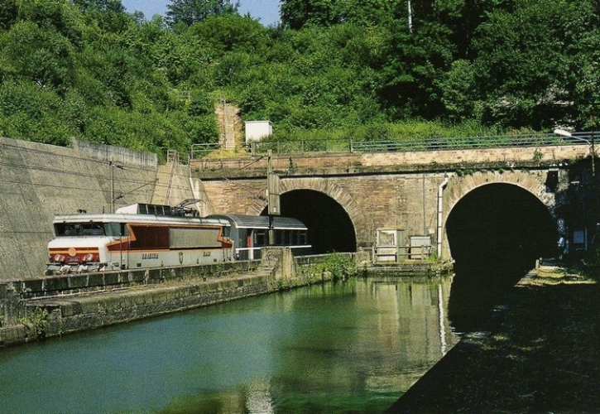
Arzviller (2678m)

Slide 13
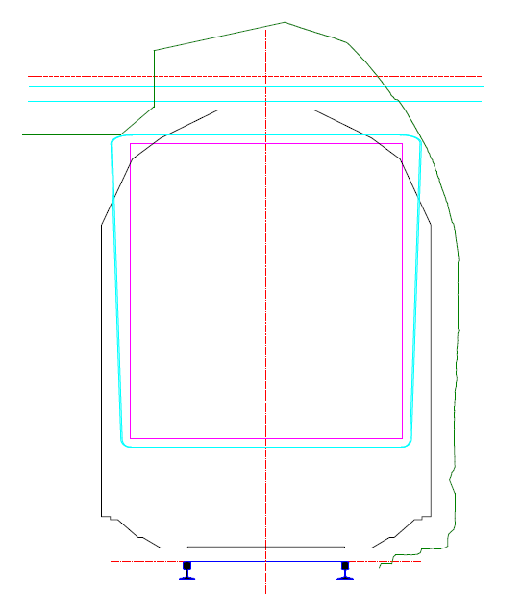
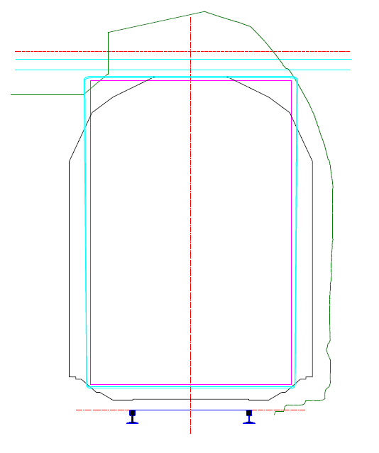
Arzviller (2678m)
400 cm
427 cm
On a floor that is 27cm above the rail head, semi-trailers of more than 373 cm cannot run through the tunnel

Slide 14
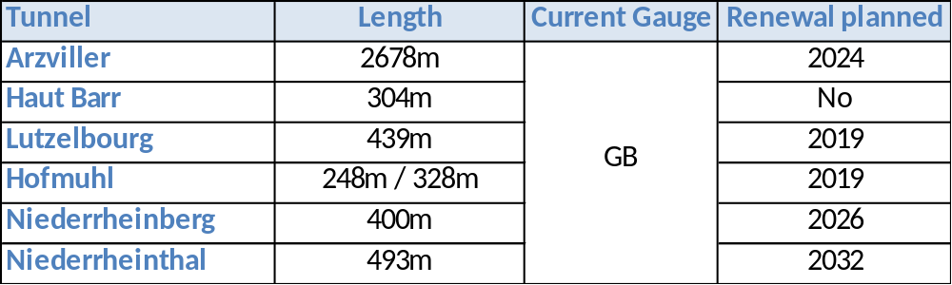
Metz-Basel
Renewals of Lutzelbourg and Hofmuhl:
in 2019
only a few tens of meters in each tunnel
therefore, for the time being, a loading gauge enhancement has not been considered

Slide 15
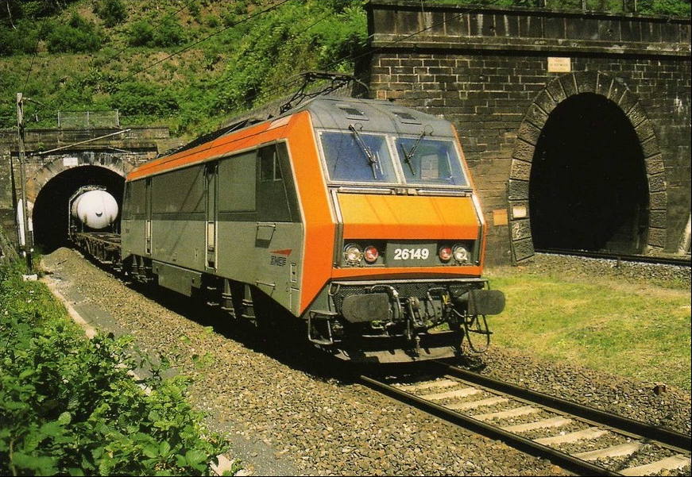
Hofmuhl : 1 tunnel per track

Slide 16
Preliminary studies
SNCF Réseau is currently performing preliminary studies for
6 tunnels between Metz and the Swiss Border and
3 tunnels between Calais and Thionville (Liart, Mercy and Fontoy)
The preliminary studies include for each tunnel
Data collection (geometric measurements)
Review of the tunnel archives (data, historical works, condition of the structure...)
Comparative Study of loading gauge enhancements: GB1, GB1 + AFM427, AFG
Definition of technical solutions
Compatibility with the condition of the tunnel and renewal works possibly foreseen
Explanatory note of the technical choices with work conditions, risks and constraints
Estimated costs and completion dates of work for each loading gauge standard
Estimated total amount of each transaction on the basis of ratios derived from similar operation
Summary table of solutions, costs and timing

Slide 17
Conclusion about studies in France
Between Calais and the Swiss border, 13 tunnels do not comply with the 427cm standard
For 4 tunnels, SNCF Réseau was able to combine loading gauge studies with renewal studies
      Works will be done in the next five years
For the remaining 9 tunnels, preliminary studies are currently underway
      Decision to do the works will depend on the results of the studies and the possibility to combine these works with renewal works

Slide 18
Combining renewals and loading gauge enhancement
There is a real interest in mutualising civil works to be done for gauge enhancement and for tunnel maintenance (renewals)
Works duration is marginally increased
Total impact on railway traffic is minimised
Total costs are minimised
This is also true for studies as they are similar in terms of soundings, plans, structure analysis, diagnostic visits. BUT :
Because gauge enhancement involves the whole of the tunnel structure instead of specific areas to be renewed. Then the combined studies costs are higher than those involved for maintenance only
=> Costs (GE+M) ≈ Costs (GE) > Costs (M)

Slide 19
Agenda
Studies in France
Studies in Luxembourg
Studies in Switzerland
19/23

Slide 20
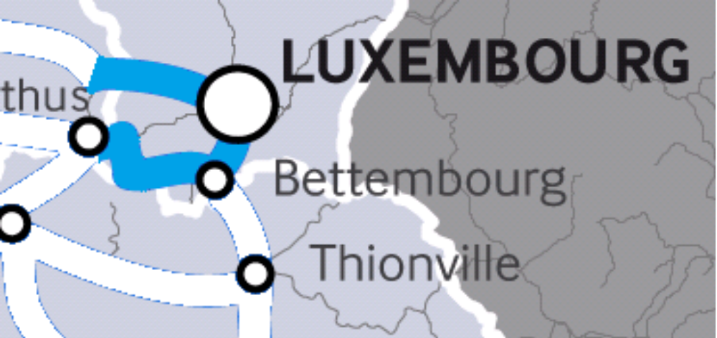
Studies launched in Luxembourg

Slide 21
Studies launched in Luxembourg
In 2013 and 1st half of 2014, three measuring campaigns have been done
The measurement data have been processed and the report sent by the contractor
The measurement data are being analysed in order to evaluate the works to be done
The study including the cost evaluation of the works will be finished by the end of 2015

Slide 22
Agenda
Studies in France
Studies in Luxembourg
Studies in Switzerland
22/23

Slide 23
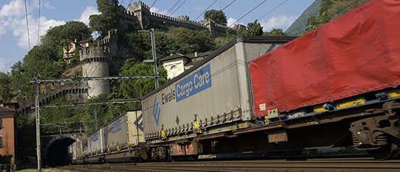
Switzerland: 4-metre corridor
In order to increase the volume of transalpine freight carried by rail rather than road, SBB will (on behalf of the federal government) upgrade the Gotthard route to a 4-metre corridor by 2020. This allows semitrailers with a 4-metre headroom to be carried.
The project, estimated to cost CHF 940M, is an important component of Switzerland's transport policy. In order to create a 4-metre corridor along the entire length of the Gotthard route, some 20 tunnels need to be enlarged and 150 alterations made to platforms, traction current systems, signalling installations and overpasses. In order for the 4-metre corridor to achieve its full potential, sections of lines in Italy will also be upgraded to a 4-metre target. To upgrade the feeder routes in Italy, the Swiss parliament also approved a loan of CHF 230M.

Slide 24
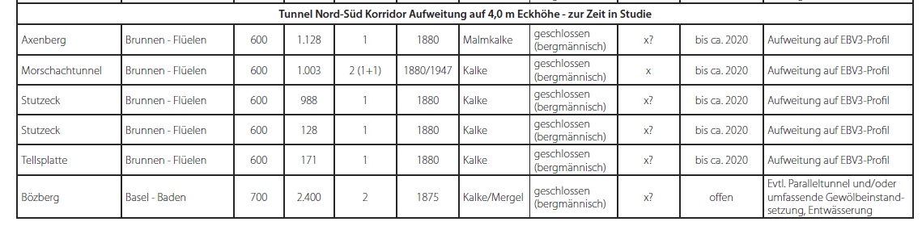
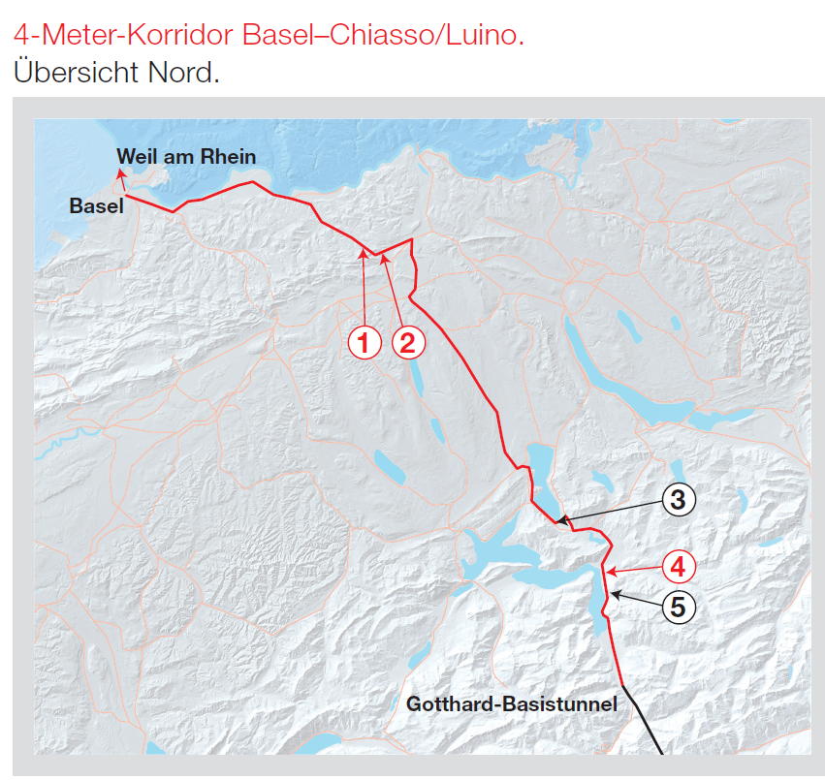
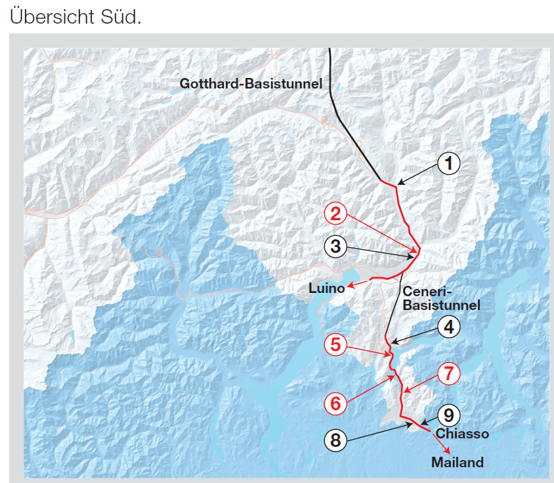

Slide 25
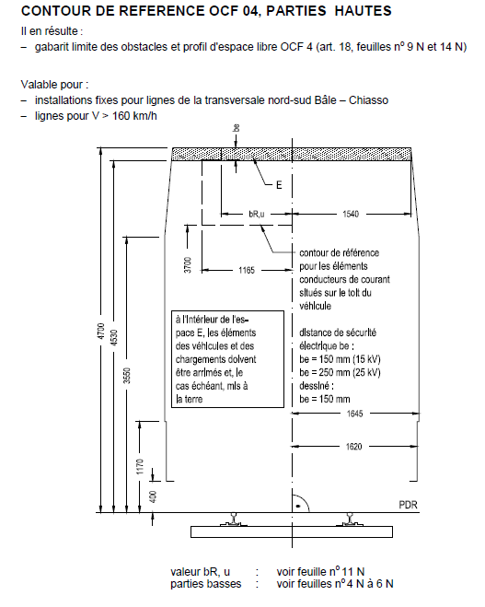
Switzerland
The Swiss loading gauge enhancement program for the North – South route is very ambitious (see chart)

Slide 26
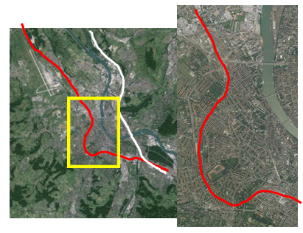
Basel area
Bs SBB –
F border
5.28 km
18 crossover
2 tunnel
Renewal 2011
P/C 45/364
Kannenfeld 1001 m
6 x-cross
Schützenmatt
286 m
4 x-cross

Slide 27
Switzerland
In Switzerland, the upgrade of the Kannenfeld and Schützenmatt tunnels between Basel SBB and the French border could cost as much as 400 M€
A “short life cycle renewal” was performed in 2011
It might be possible to consider loading gauge enhancement when the next renewal is performed (around 2026)
It is worth coordinating the Swiss and French projects at the ministry level

Slide 28







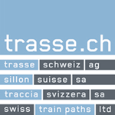


The sole responsibility of this publication lies with the author.
The European Union is not responsible for any use that may be made of the information contained there in.
Contact
oss@rfc2.eu
www.rfc-northsea-med.eu
ACF
28/20
28/23
Notes:
28

